Slide 1

Managing Performance
Webinar 3
Martin Pike

Slide 2
Learning Outcomes
At the end of this session, you should be able to:
Analyse a profit and loss account and statement of financial position
Identify the major categories of ratios that can be used for analysing financial statements
Calculate and explain key ratios for assessing the financial performance and position of a business
Explain the purpose and construct a cash budget
Identify costs in relation to break-even analysis

Slide 3
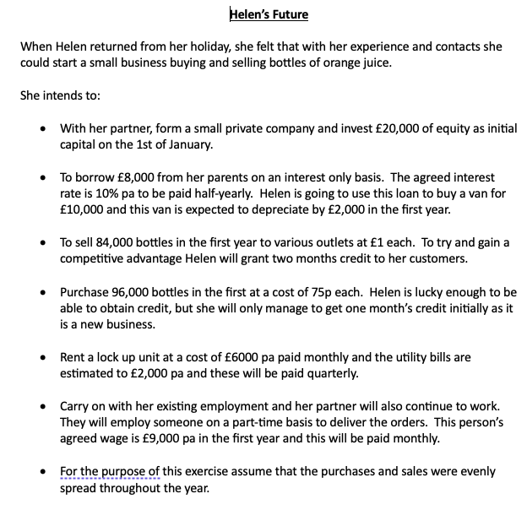

Slide 5
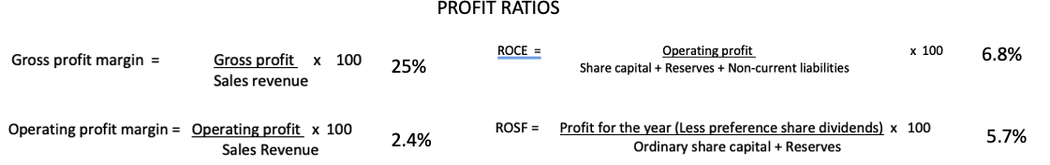
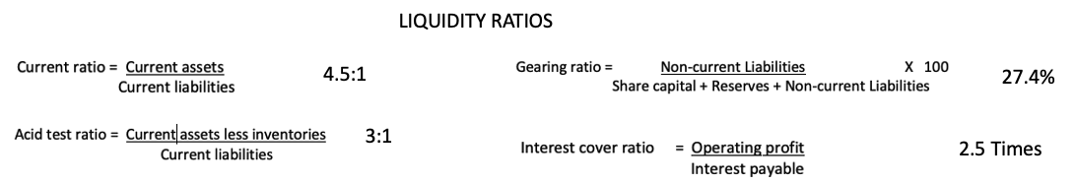
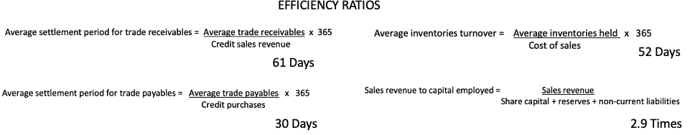
Helen’s Ratio Summary

Slide 6
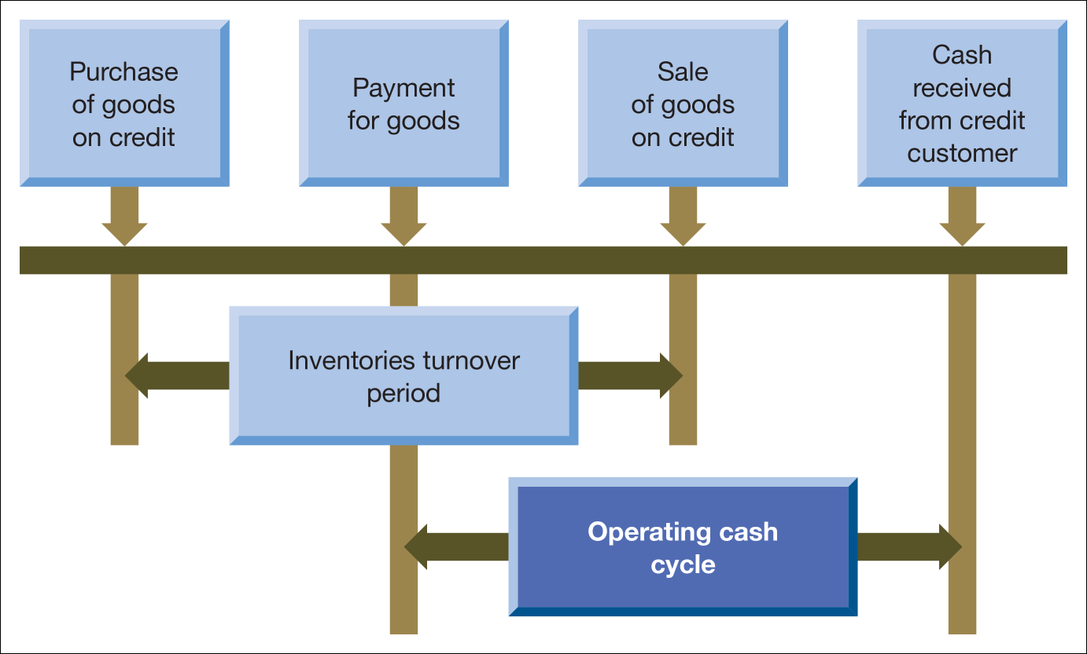
The Operating Cash Cycle

Slide 7
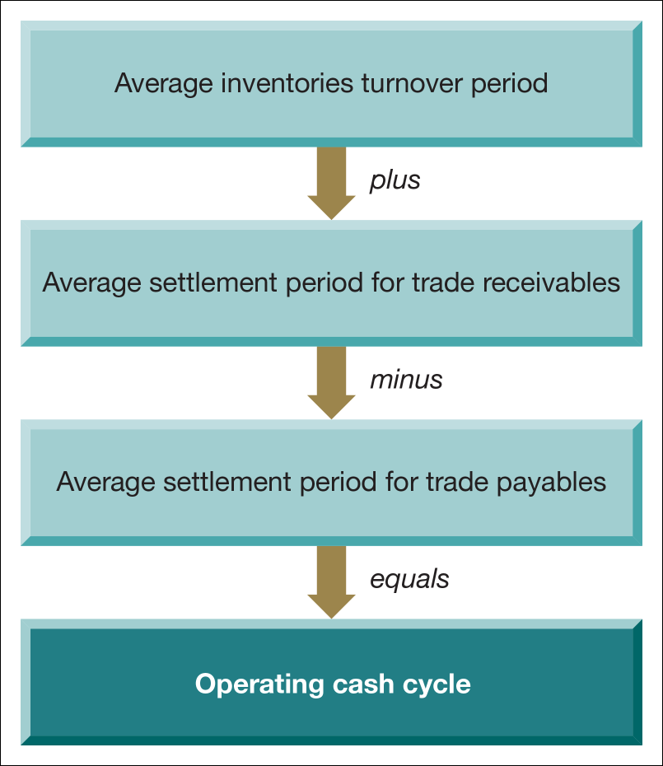



Helen’s Operating Cash Cycle
52 Days + 61 Days – 30 Days = 83 Days Between paying and receiving cash

Slide 8

The Cash Budget

Slide 10
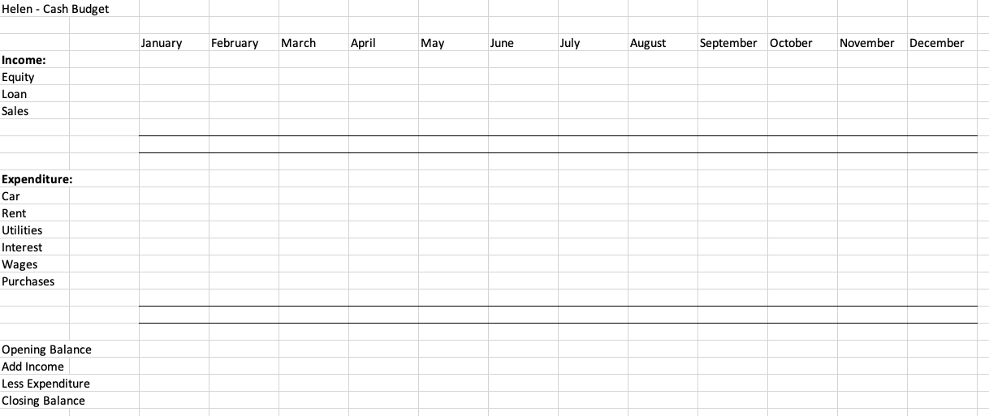

Slide 11
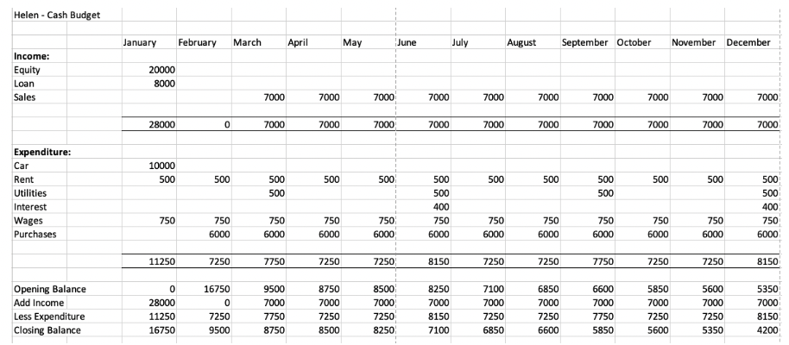
Helen – Cash Budget Year 1

Slide 12
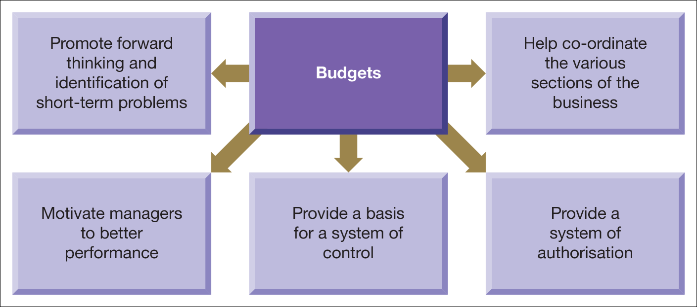
Budgets are seen as having five main benefits to the business

Slide 13
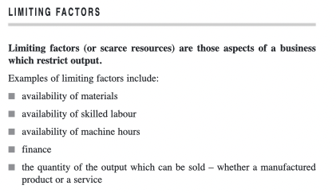

Slide 14
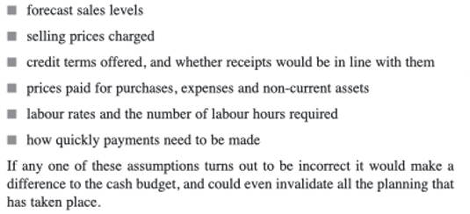
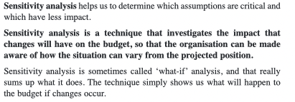
Some assumptions made during Budgeting

Slide 15

Costing and Break-Even

Slide 16
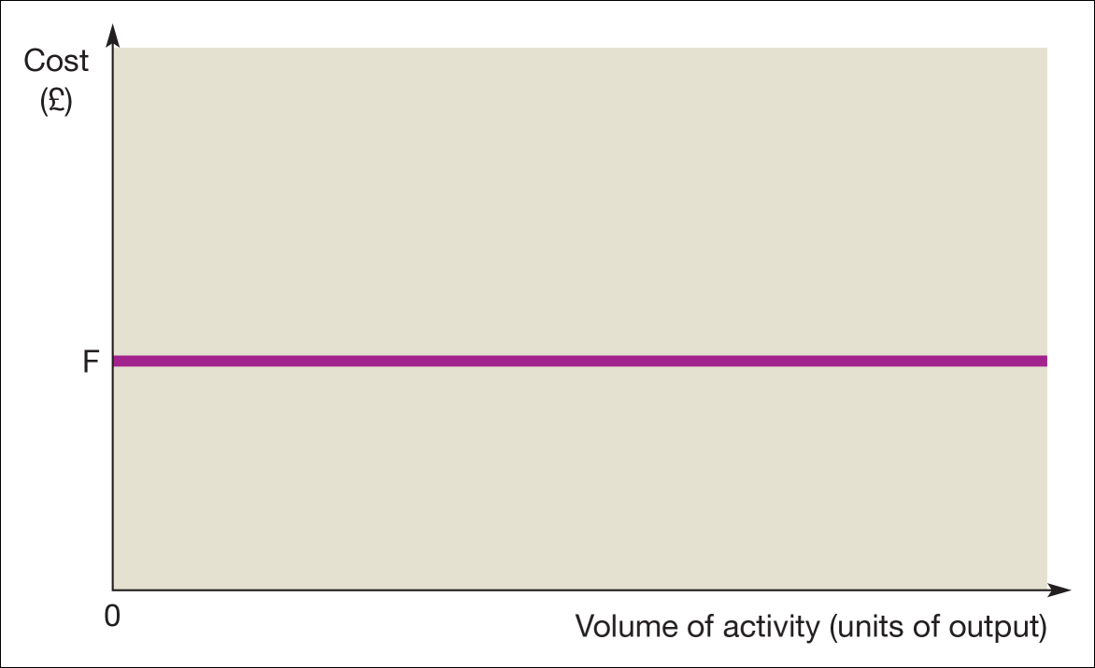
Graph of fixed cost against the volume of activity

Slide 17
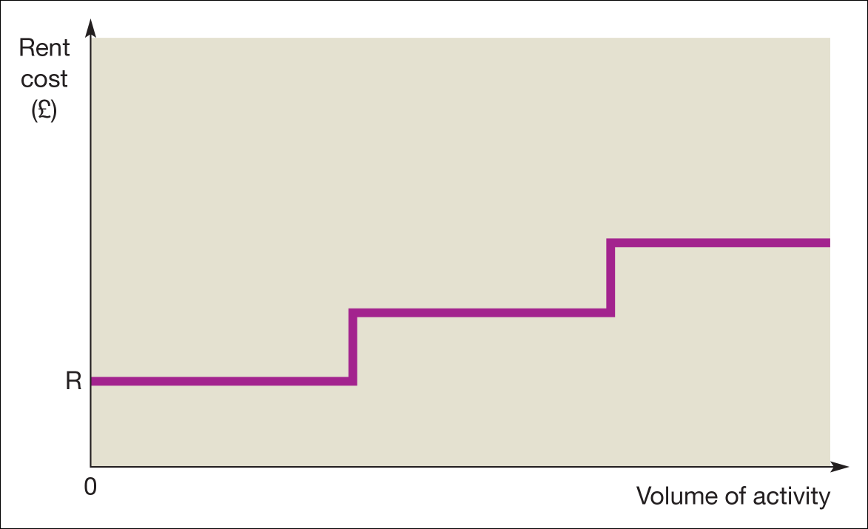
Graph of rent cost against the volume of activity

Slide 18
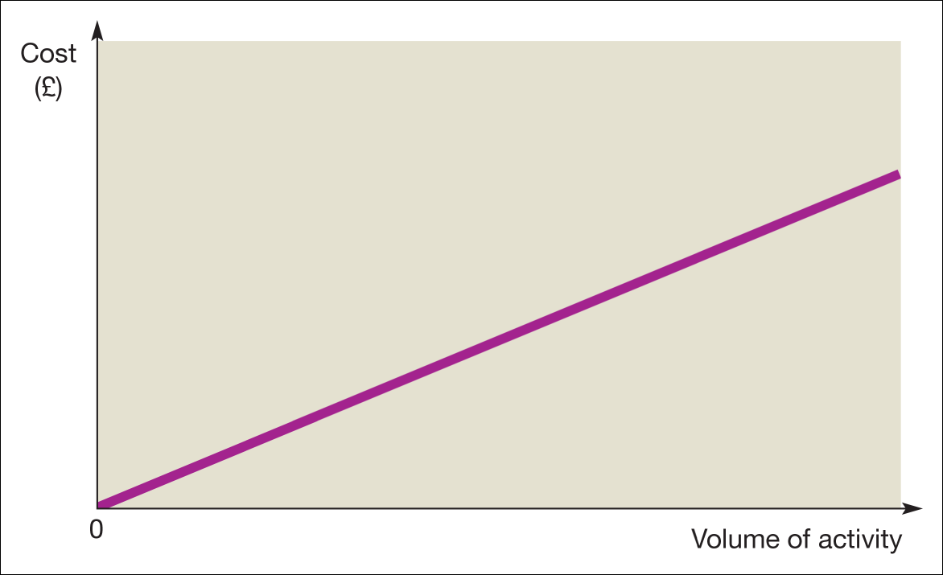
Graph of variable cost against the volume of activity

Slide 19
Break-even Analysis | Breakeven Chart - Bing video

Slide 20
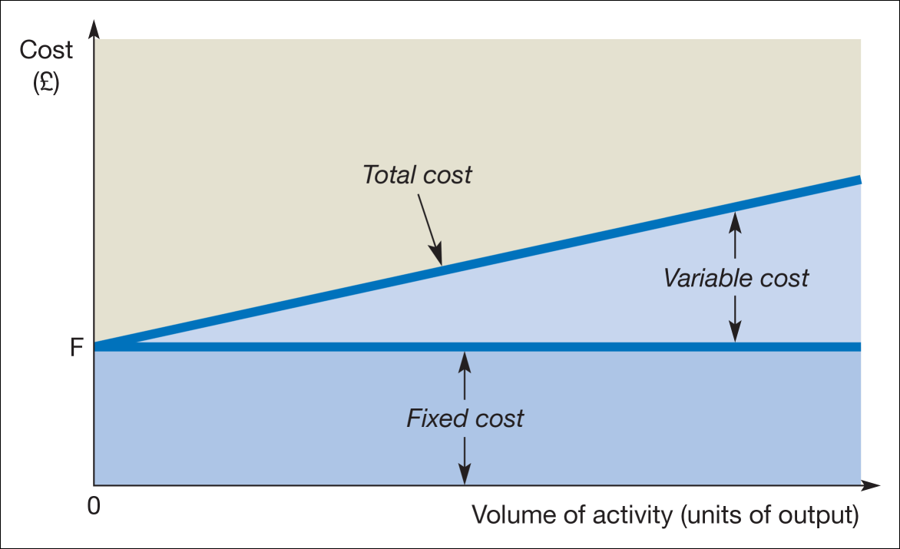
Finding the break-even point

Slide 21
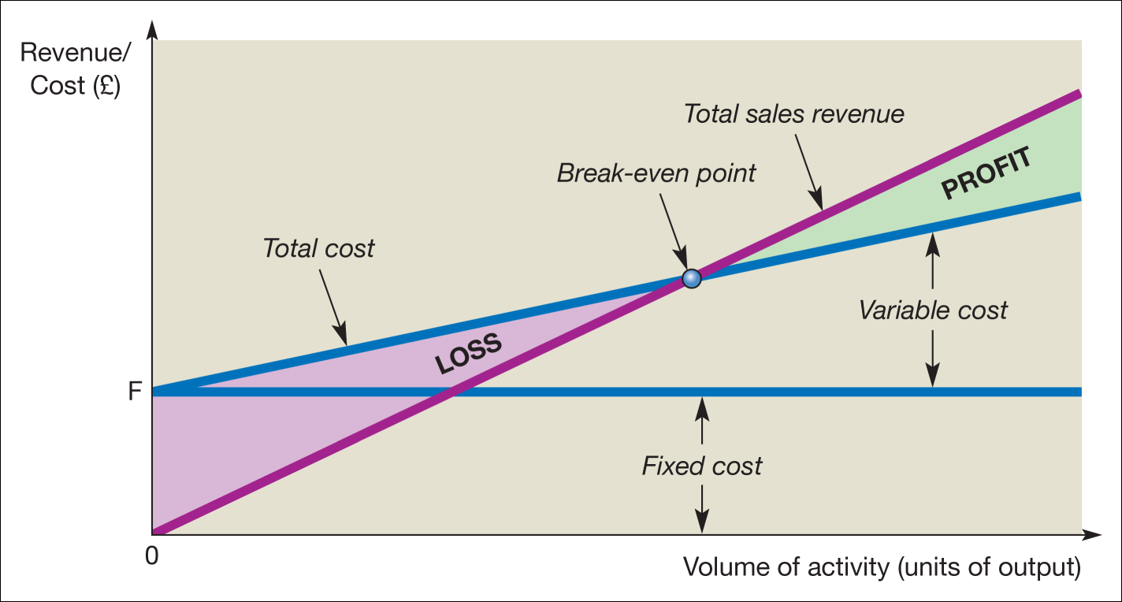
Break-even chart

Slide 22
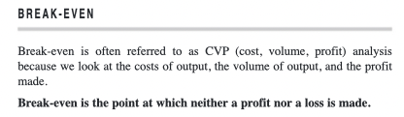

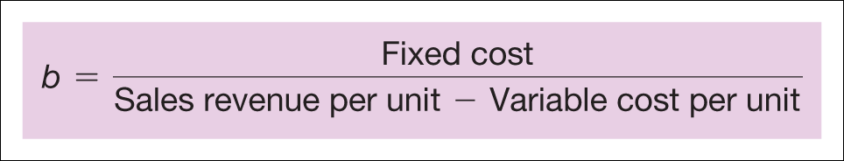

Slide 24
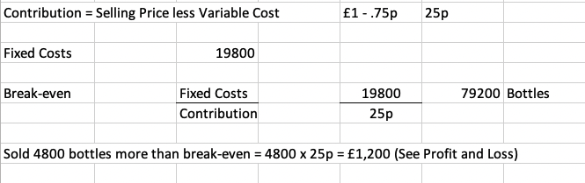
CALCULATION OF BREAK-EVEN POINT

Slide 25
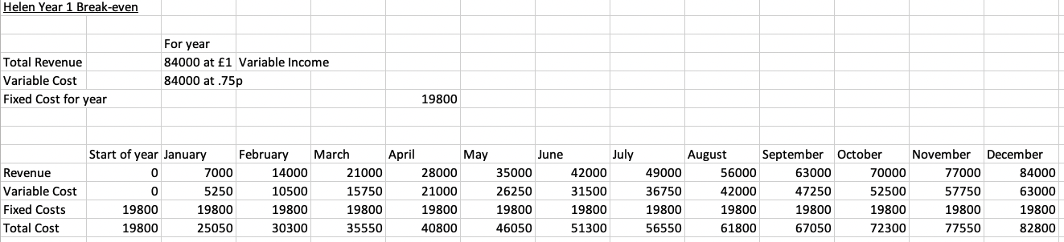
BREAK-EVEN USING A TABLE

Slide 27
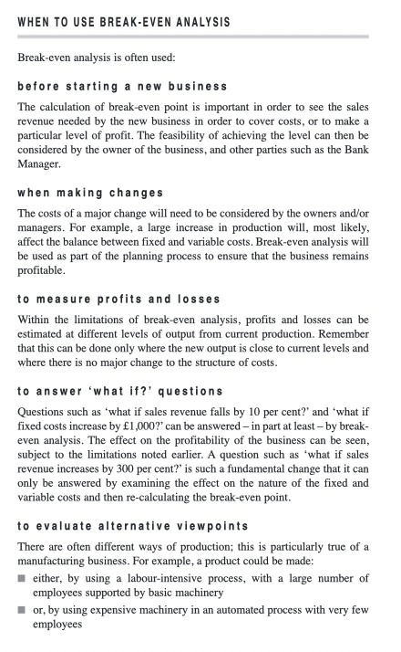

Slide 28


Slide 29

The following is a practice exercise together with solution - Just for Fun!!!

Slide 30
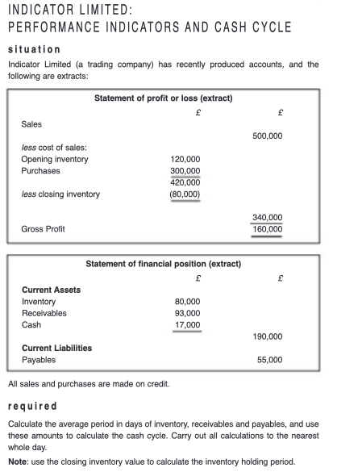

Slide 31
